Slide 1

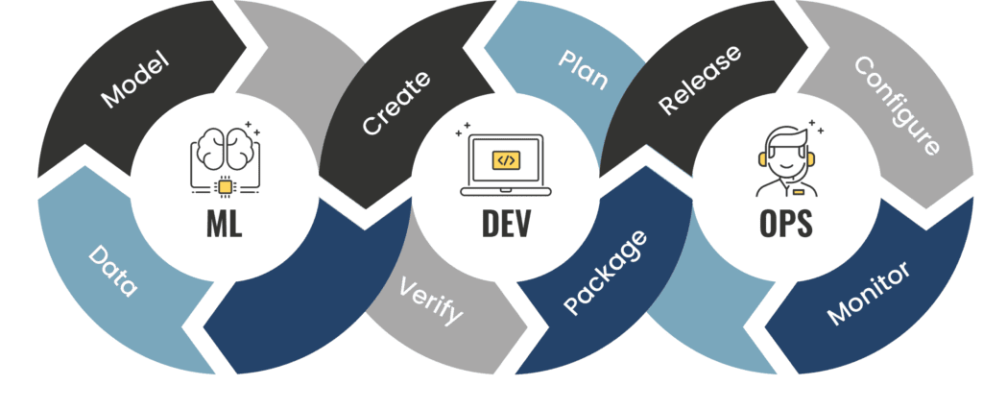
From Data Acquisition to Model Deployment – End-to-End ML Lifecycle
ANJUM JAVED
31st March 2024

Slide 2
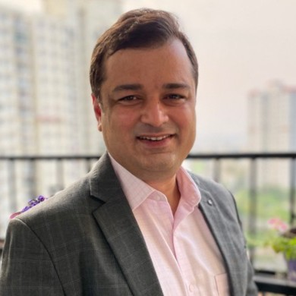

Seasoned AI Innovation and Thought Leader with extensive background in AI ML Data Science. He has more than 2 decades of experience and has held key leadership positions in the Data, AI and Analytics space in large multinational organizations like Accenture, Wipro, WNS and niche AI start ups. His expertise lies in the AI and emerging tech space where he has played a pivotal role in driving innovation and spearheading groundbreaking projects. In addition to his corporate endeavours Anjum is also actively involved with E-cell IIT Bombay where he serves as a mentor for Deep Tech AI startups.
Anjum Javed | LinkedIn

Slide 3
Agenda
-Industrial Example
-ML Lifecycle
-MLOps

Slide 4
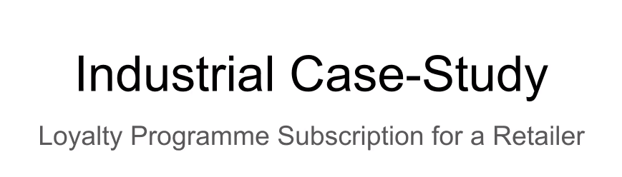

Slide 5
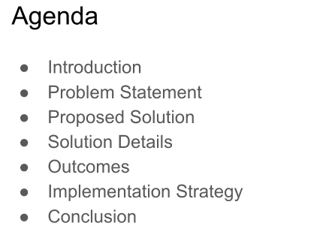

Slide 6
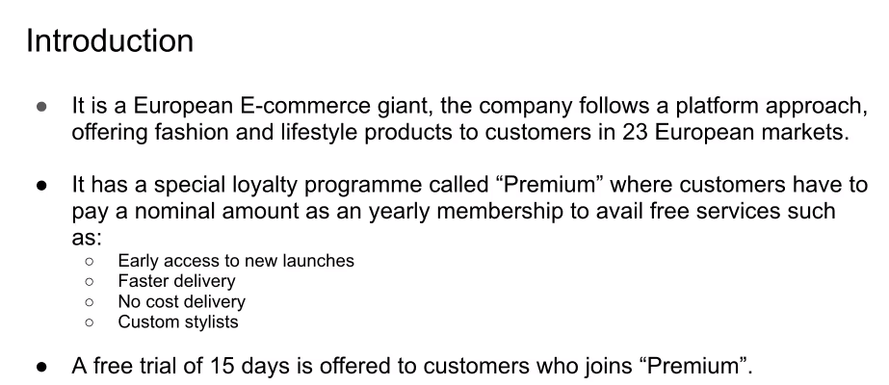

Slide 7
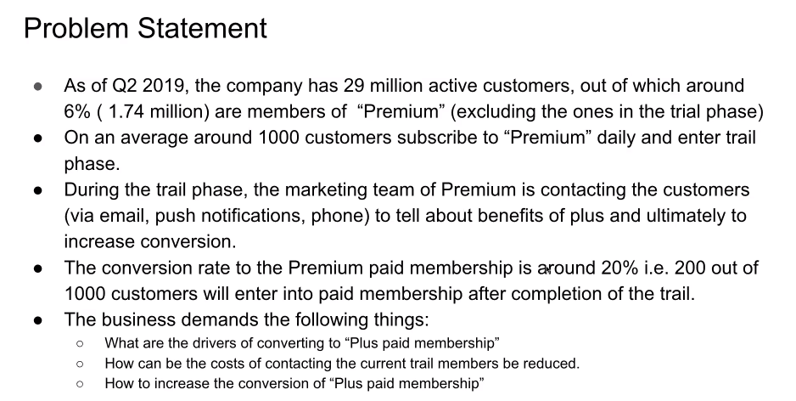

Slide 8
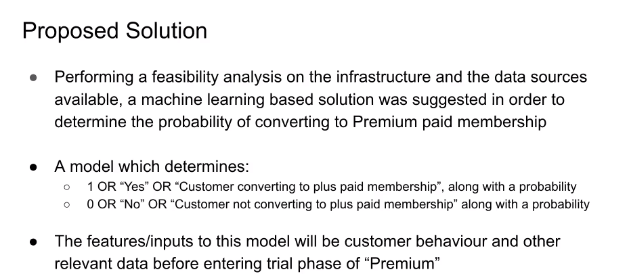

Slide 9
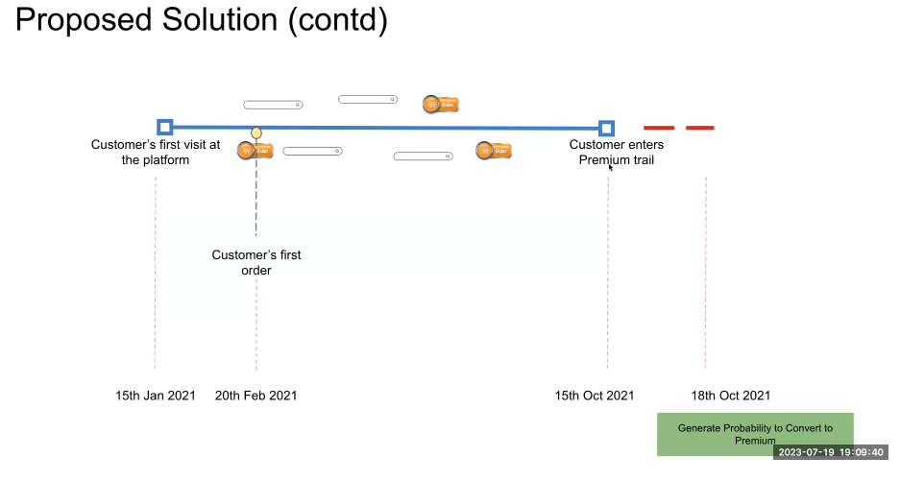

Slide 10
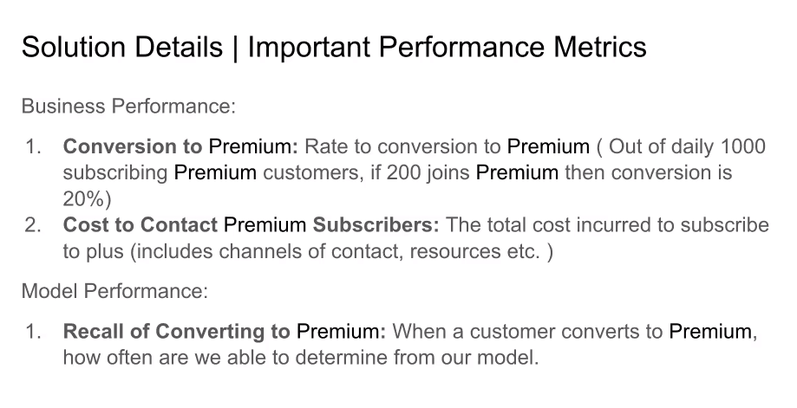

Slide 11
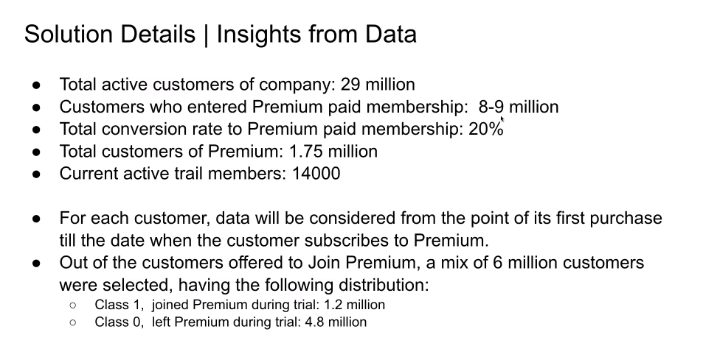

Slide 12
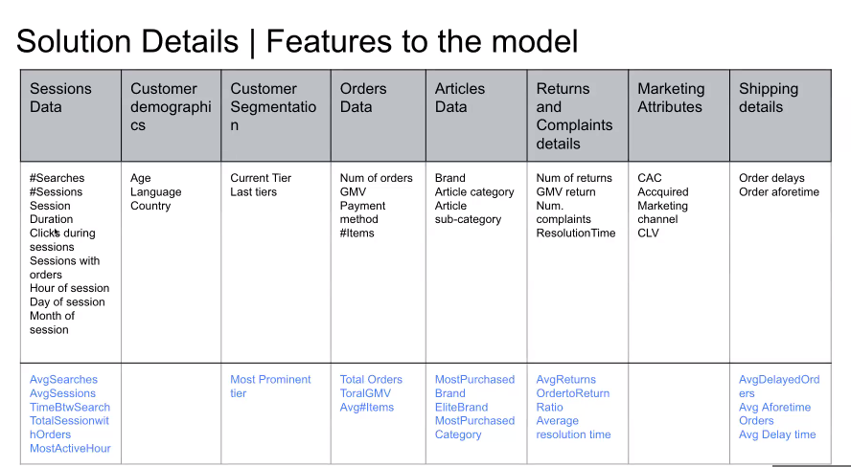

Slide 13
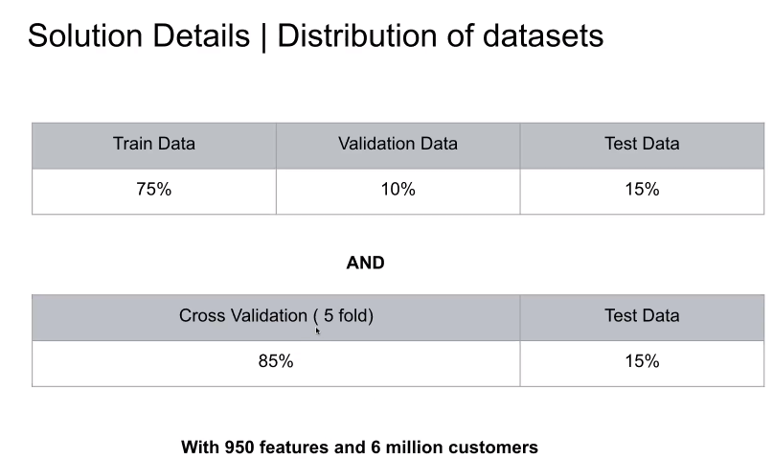

Slide 14
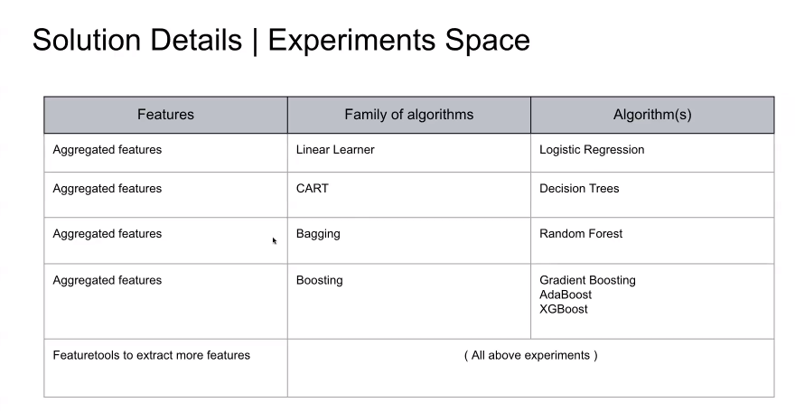

Slide 15
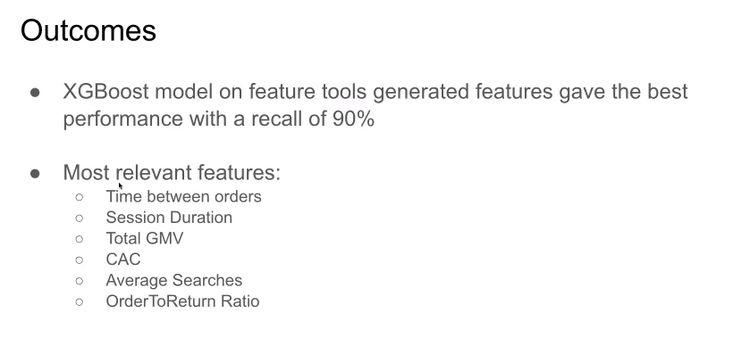

Slide 16
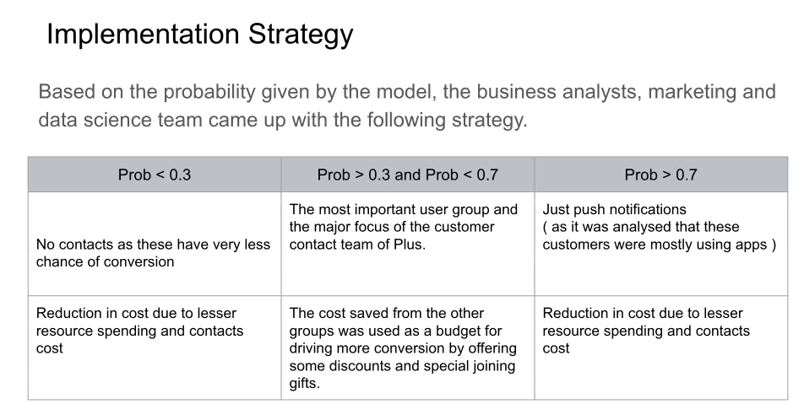

Slide 17
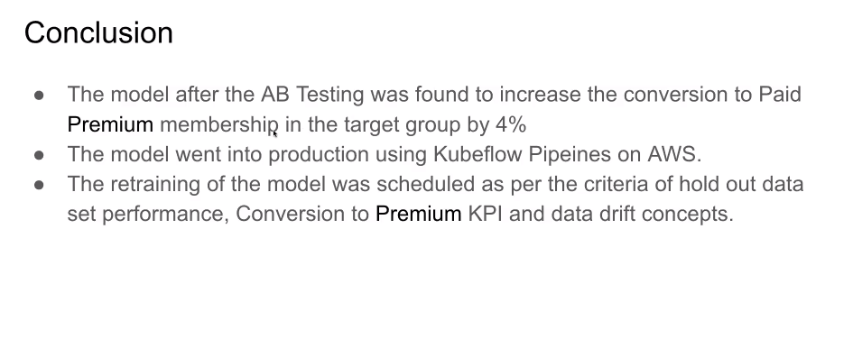

Slide 18
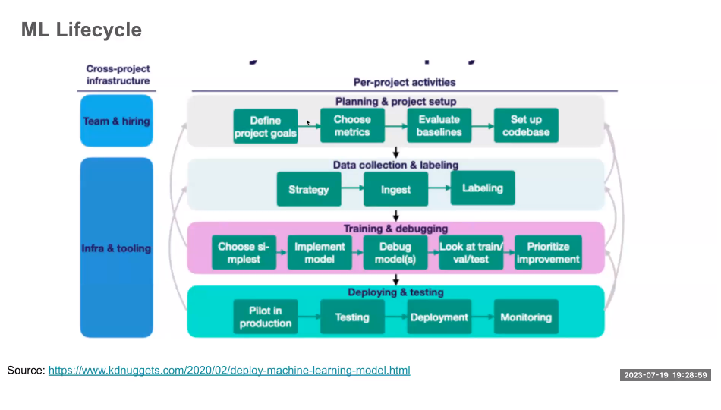

Slide 19
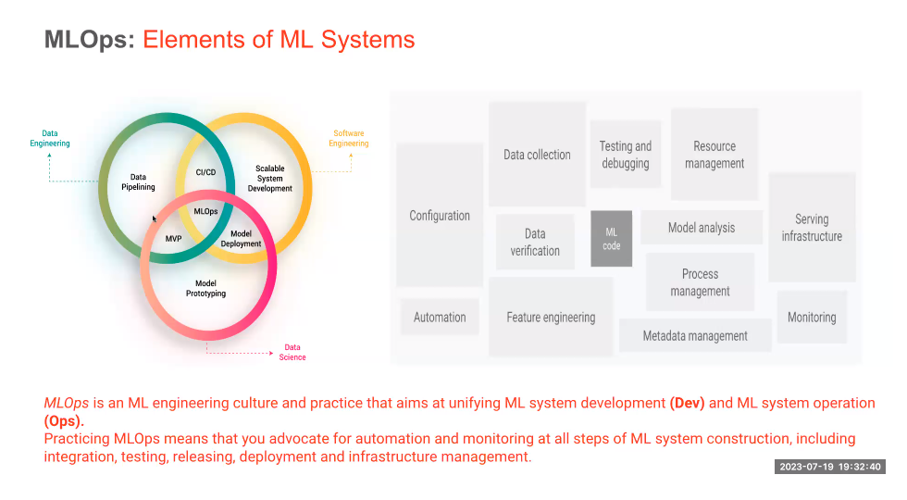

Slide 20
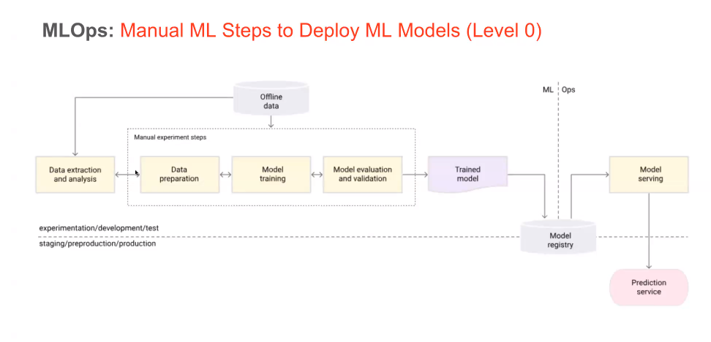

Slide 21
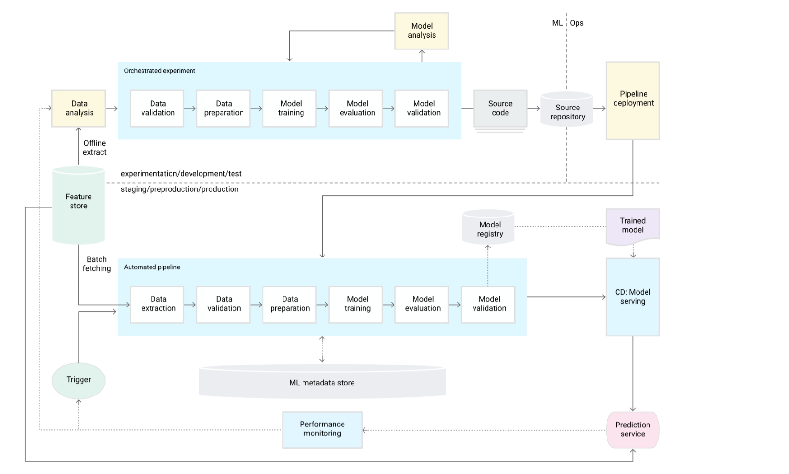
MLOps: ML Pipeline Automation (Level 1)
https://cloud.google.com/architecture/mlops-continuous-delivery-and-automation-pipelines-in-machine-learning

Slide 22
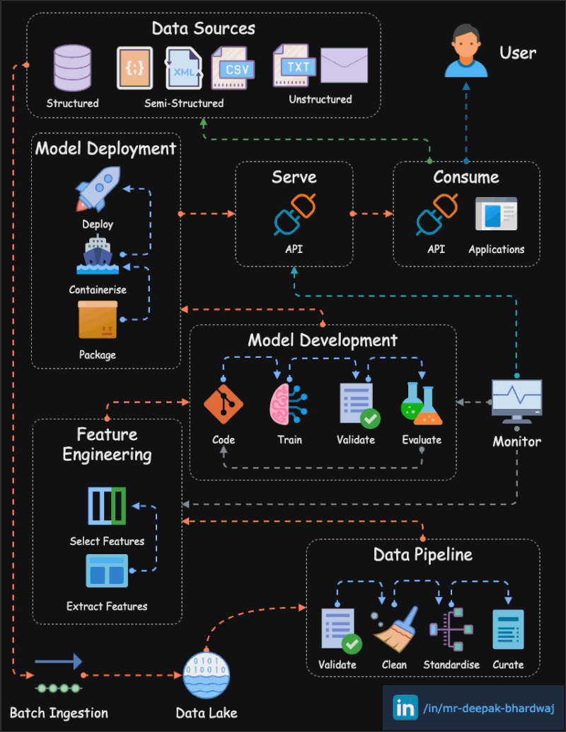
ML Model Lifecycle – Beneath the Hood

Slide 23
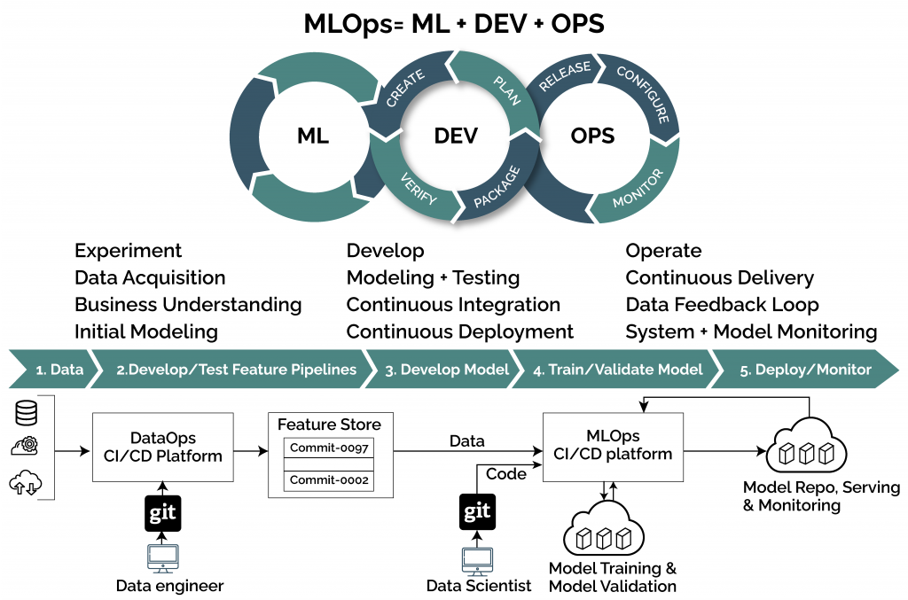

Slide 24
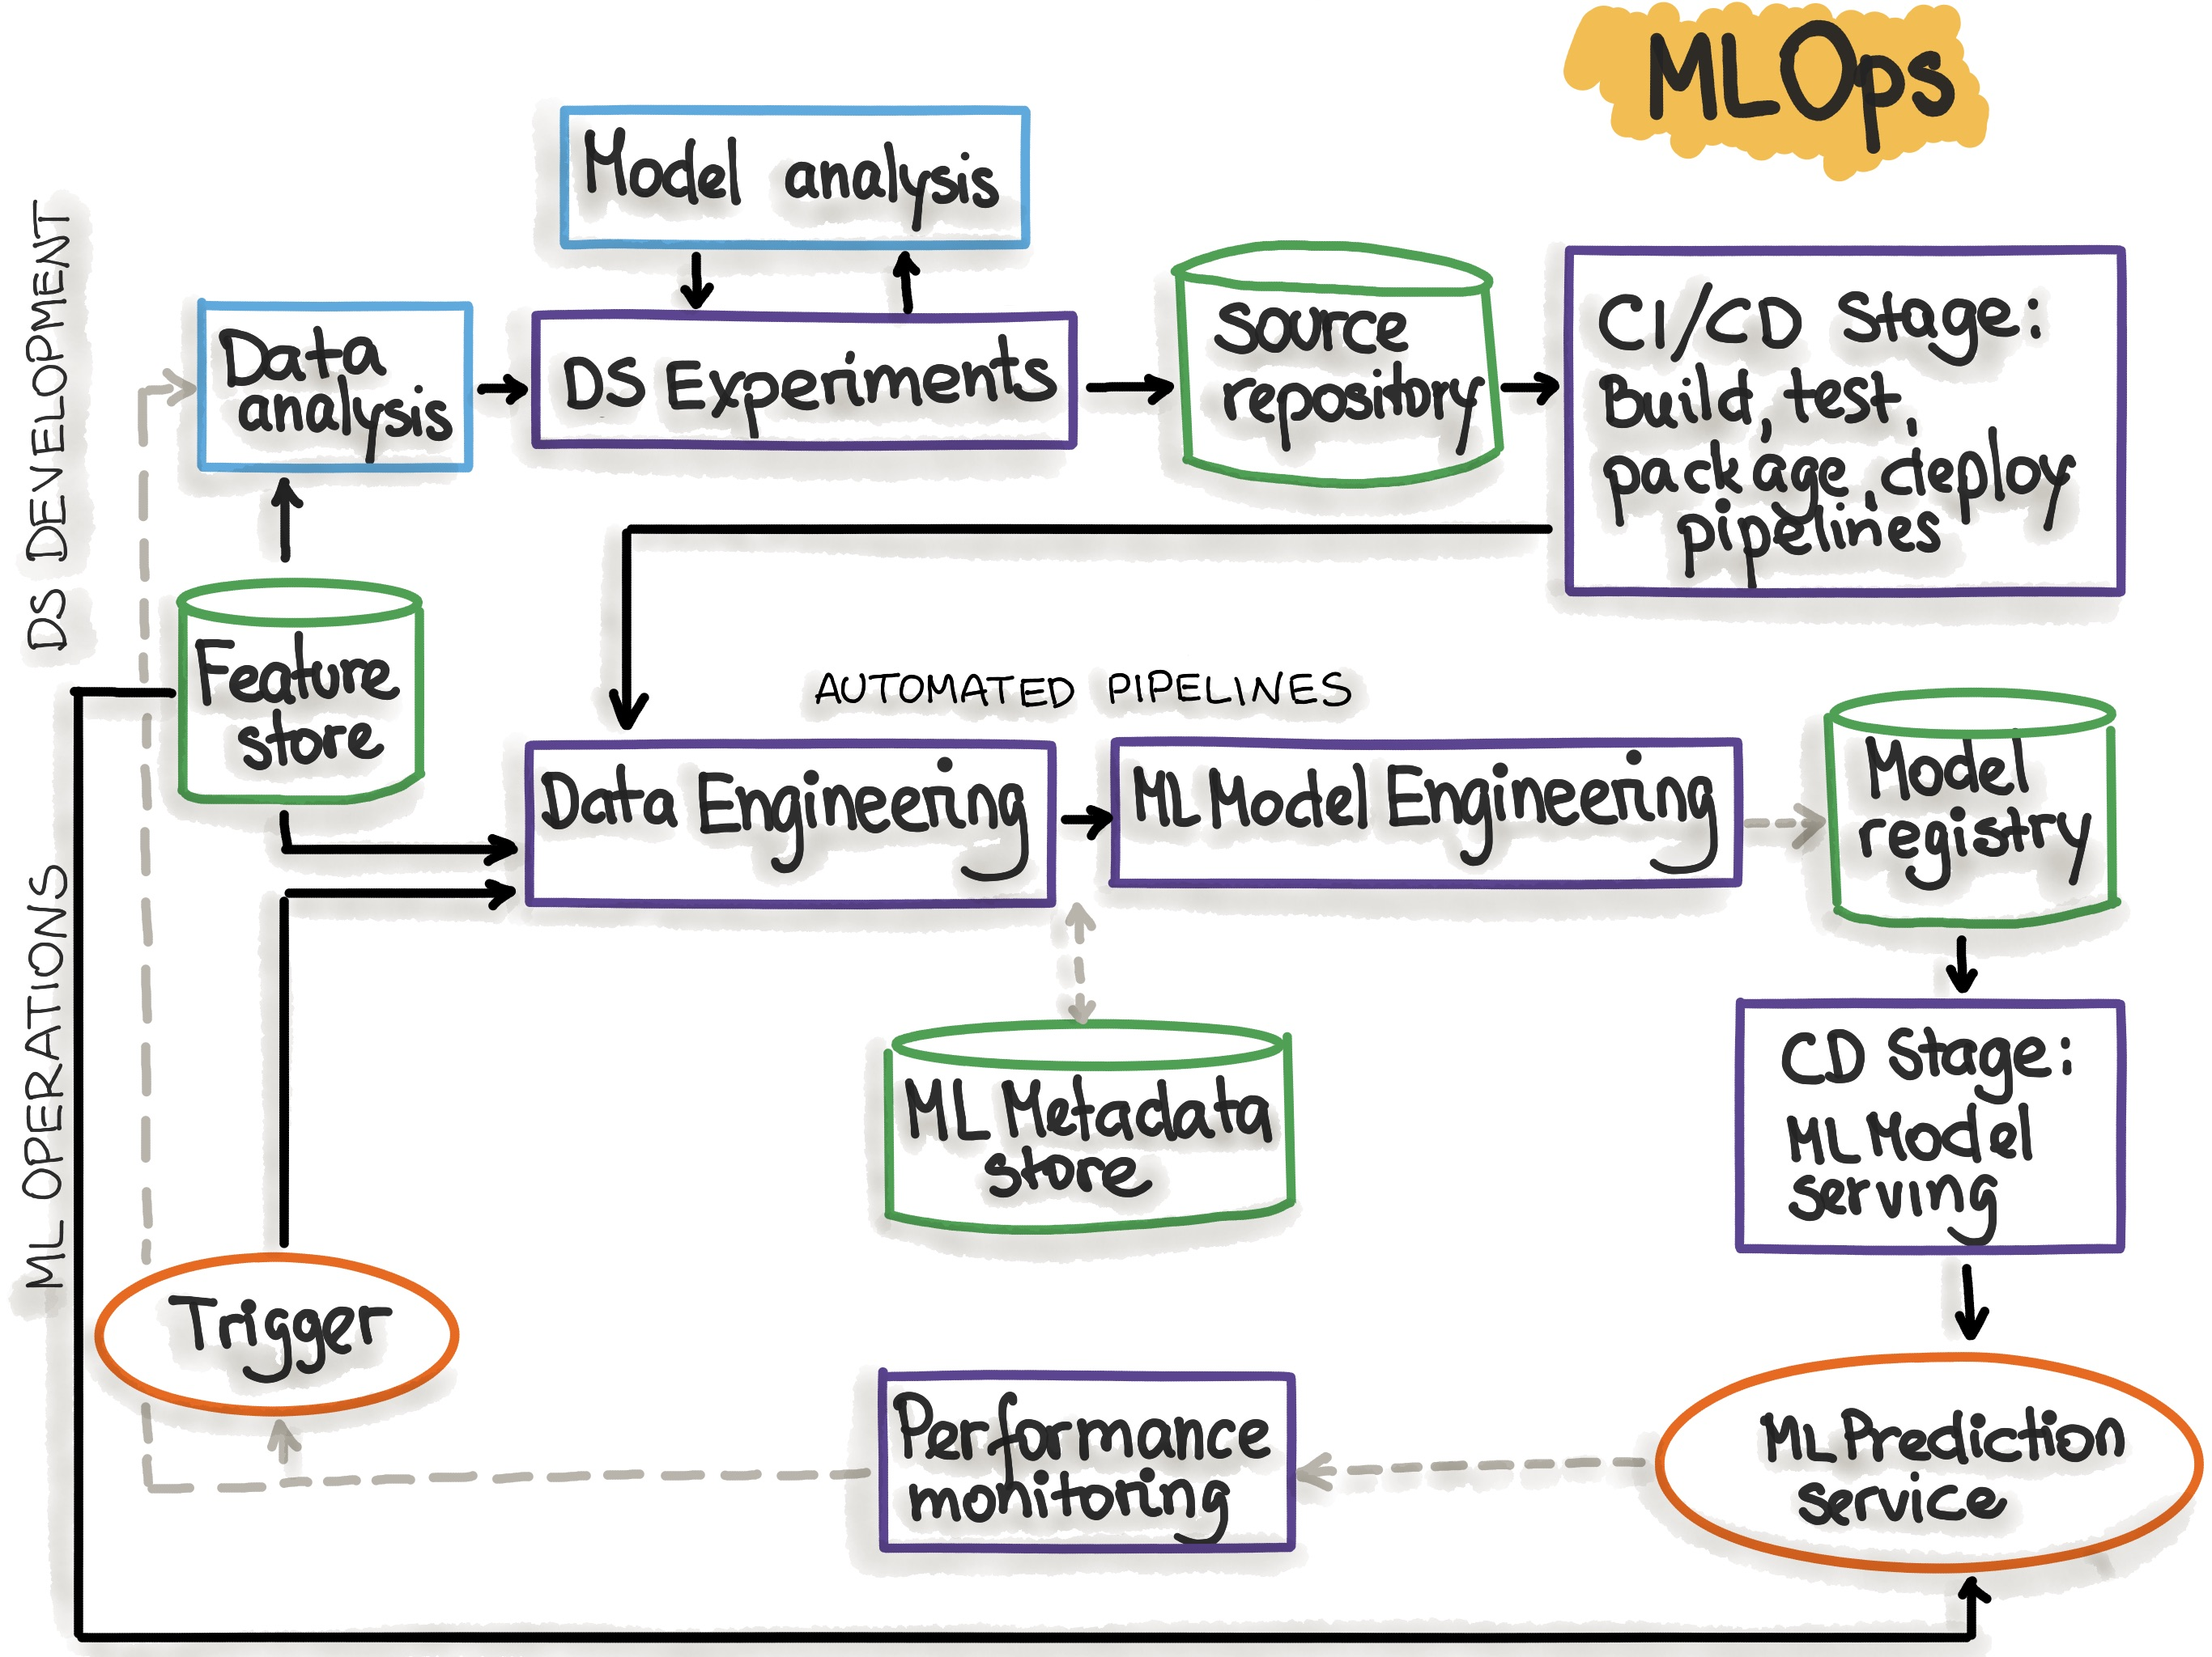

Slide 25
Q/A

Slide 26


